Slide 1


Software Project Lab-1
Machine Learning Algorithms
Name : Abir Ashab Niloy
ID : BSSE-1315
Supervisor:
Kishan Kumar Ganguly
Assistant Professor,
Institute of Information Technology,
University of Dhaka

Slide 2
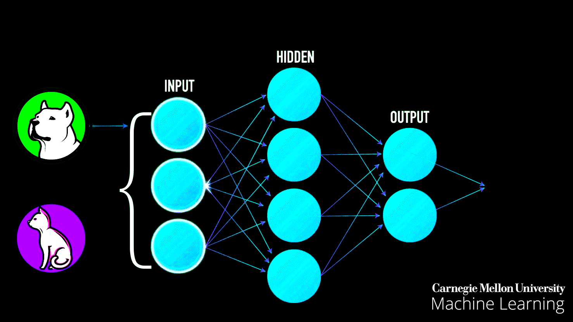
Machine Learning
Machine learning is one of the most sought after technologies in the modern world.
It is used to make predictions about a data. It generally takes a training dataset to train itself and then check the accuracy on test dataset.
Finally it takes the input to predict about it.

Slide 3
OBJECTIVES
There are several algorithms regarding machine learning in which some of them are widely used.Here I will construct some introductory and widely used ML algorithms using C,C++ which will make my road of learning ML easier and will build a strong base for doing something bigger in future.The algorithms I will construct are given below:
-Logistic regression
-Decision tree
-Random forest
-K-Nearest Neighbor(KNN)
-K-means

Slide 4

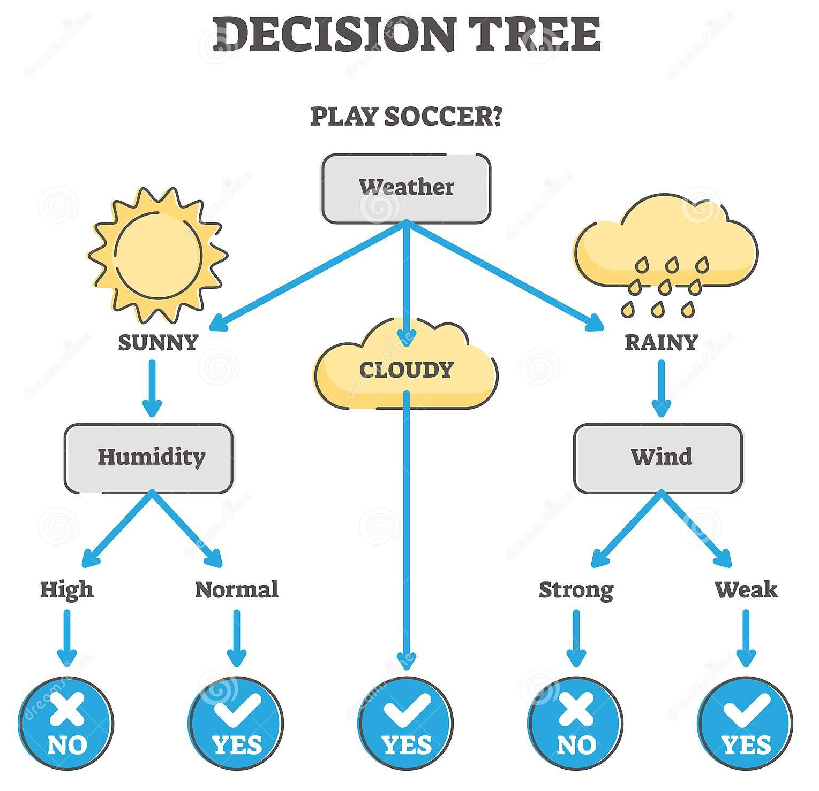
Decision Tree
Decision Tree Algorithm classifies a dataset based on some splitting criteria.
It decreases the randomness of the data in each stage and specifies the categories to classify the data.

Slide 5
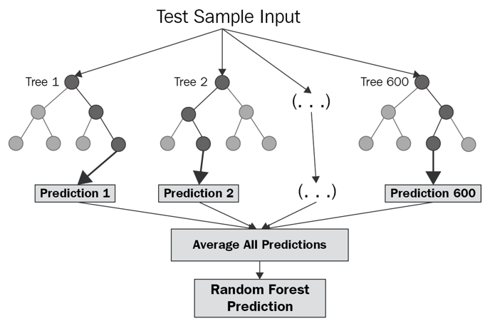
Random Forest
Random forest is implemented using multiple decision tree. This is used to solve the problem of over specification/overfitting.
The program makes several decision trees, each time with different criteria and then gives the average result of all the trees.

Slide 6
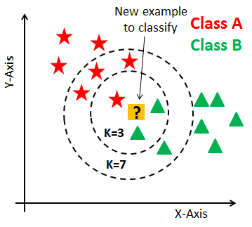
K-Nearest Neighbours
The K-nearest neighbours algorithm plots all the dependent and independent data in a n-dimensional graph.
And then finds k number of neighbours to the test data and then returns the class with highest frequency among those k neighbours.
Here the algorithm will return B for k=3 and A for k=7.

Slide 7
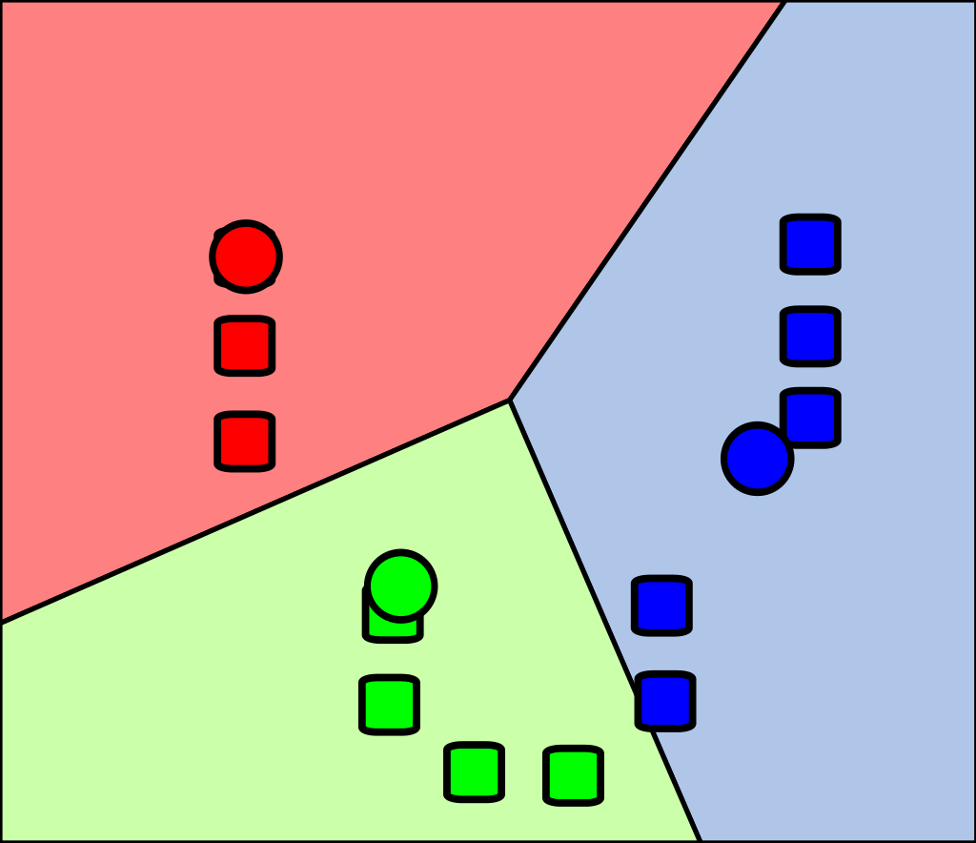
K-Means
It divides the whole data points in k different clusters.Here k = 3.

Slide 8
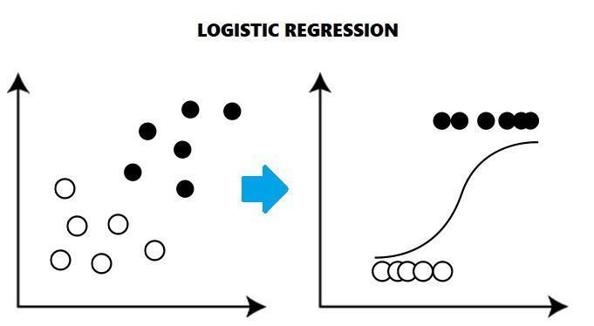
Logistic Regression
Logistic regression is used in various fields, including ML,most medical fields and social science.

Slide 9
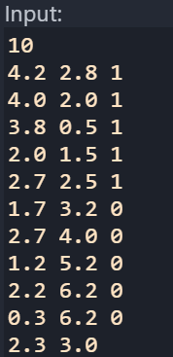
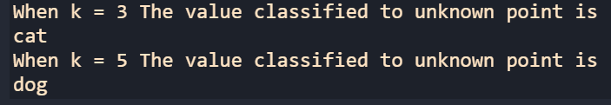
Progress till now….
I have worked on KNN, K-Means and Decision Tree algorithms.
KNN : Here I take some data point along with their class as input (i take the class as 1, 0 where 1 means dog and 0 means cat).After taking input i put an unknown point for knowing the class of this point(0 or 1).
Whenever I take different k get different values.Here is the input and output for my KNN Algorithm -

Slide 10
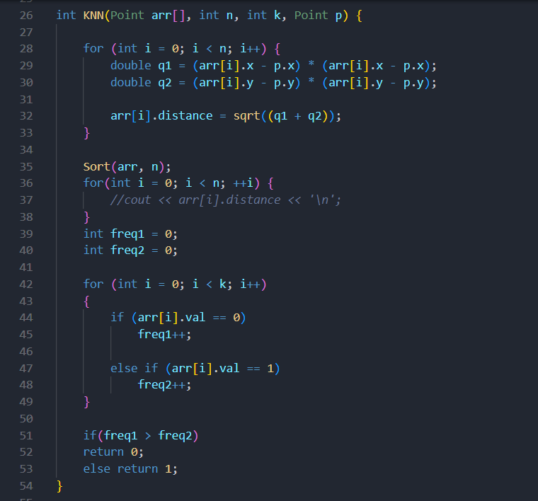
kNN function
Knn function

Slide 11
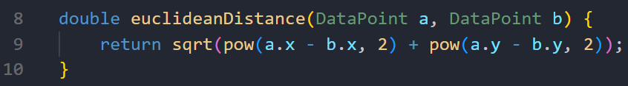
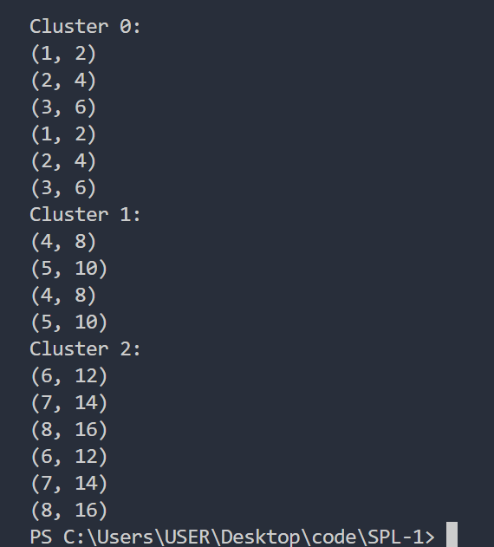
Progress till now….
K-Means : Here i take the data point as input
8 point -> (1,2),(2,4),(3,6),(4,8),(5,10,)(6,12),(7,14),(8,16)
And take pass the values along with k = 3 to the function K-means.Here i used euclidean equation for getting distance between two point.
Euclidean function:
And output of my code for the data above is :

Slide 12
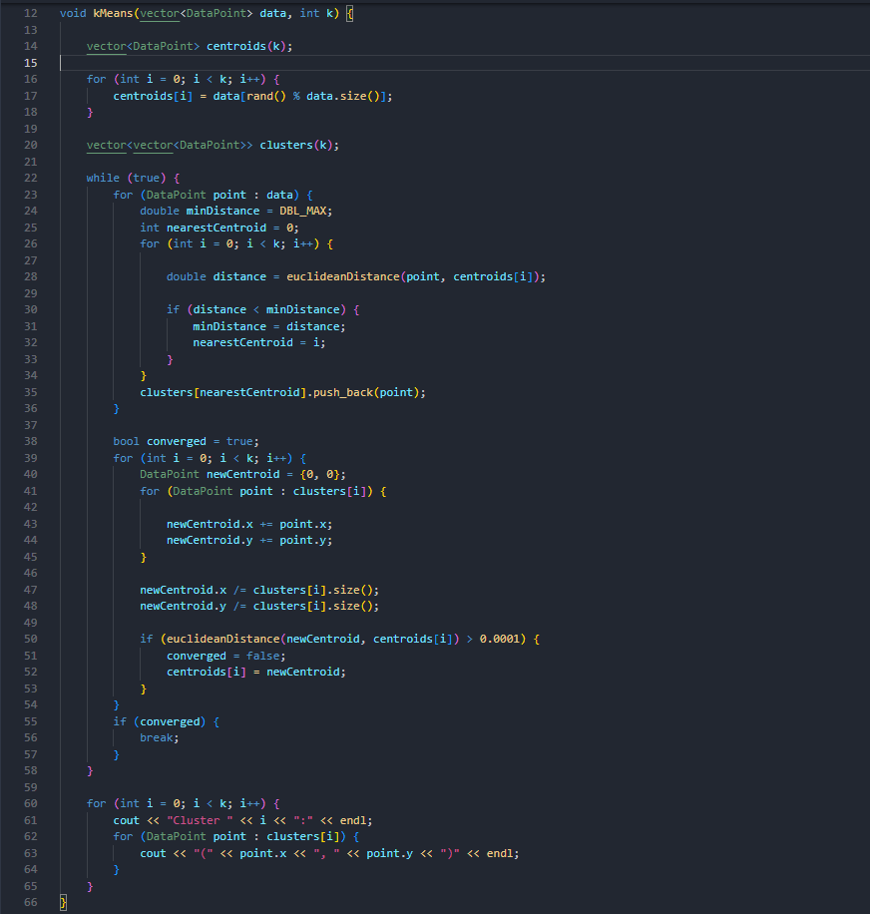
K-Means Function

Slide 13
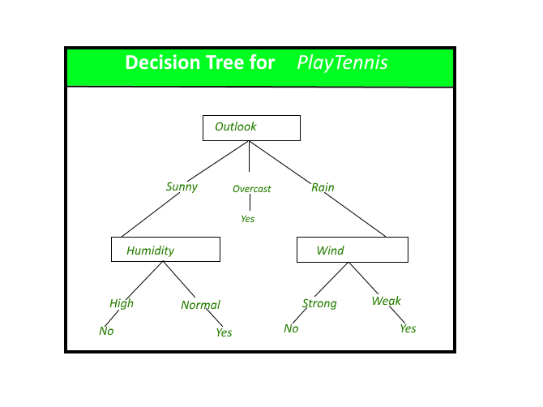
Progress till now….
Decision tree : Here i used ID3 (Iterative Dichotomiser 3) algorithm for building a decision tree.The tree I used as sample is :

Slide 14
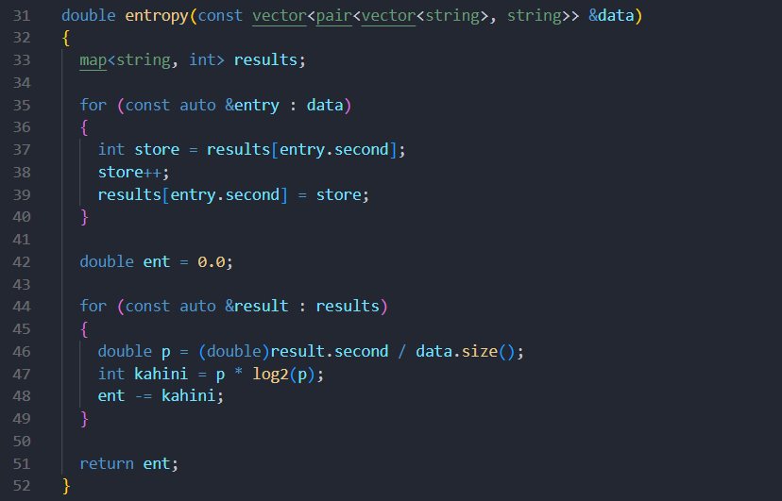
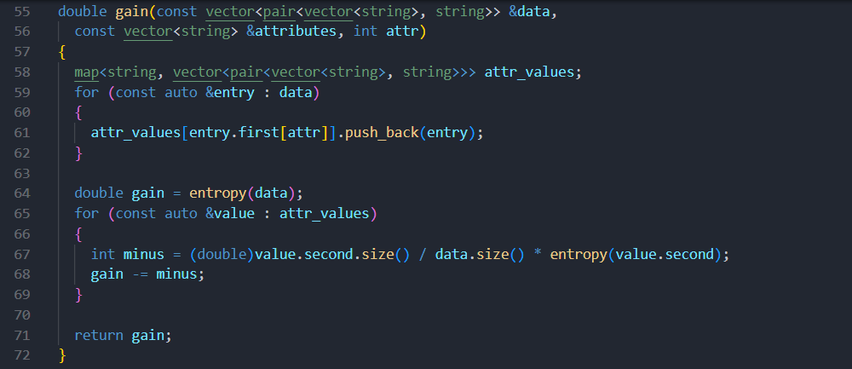
Decision Tree function
Entropy function
Gain function

Slide 15
To be continued…
My future goals regarding this project is to implement rest of the algorithms as well as making all the algorithms highly productive and realistic.
Here is my Repository link for spl-1: https://github.com/Abir-Ashab/SPL-1

Slide 16
THANK YOU!!!

